Slide 1

SIMTOLL DYNAMICS
A GPS Toll Based system simulation using python
BY TEAM CLASSIC CODERS

Slide 2


INDEX
 | 03. The Evolution of Tolls 04. Problem Statement 05. Proposed Solution 06. Unique Idea Brief 07. Features Offered 10. Process Flow 11. Architecture Diagram 12. Results 15. Technologies used 16. Meet The Team 17. Conclusion

Slide 3
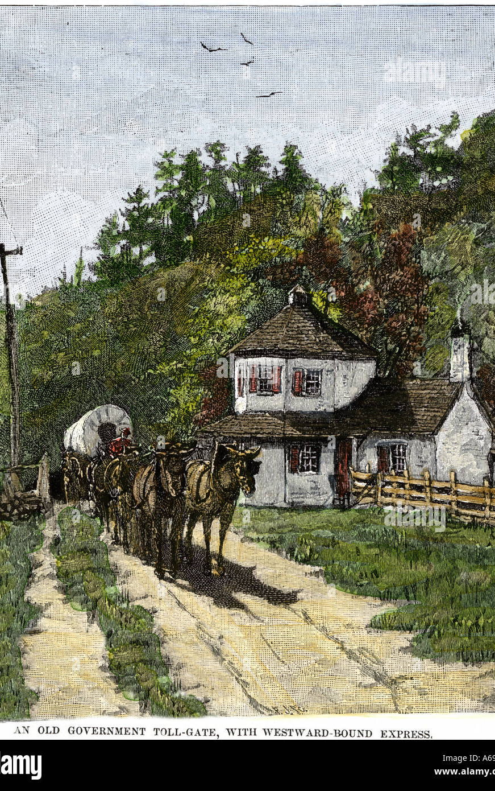
From Ancient Roads to Modern Highways: The Evolution of Toll Systems
Originating in the early Roman Empire and ancient Greece, tolls were first introduced to fund the construction and upkeep of roads, ensuring safe and reliable travel for traders and citizens.
Throughout the Middle Ages, tolls became a common means for lords and monarchs to generate revenue, supporting the construction of bridges and highways.
In the modern era, the advent of automobiles and the exponential growth of road networks necessitated further advancements, giving rise to electronic toll collection systems that aimed to reduce congestion and enhance efficiency.

Slide 4

PROBLEM STATEMENT
Manual toll collection processes are often inefficient, leading to long queues and traffic congestion at toll booths. This wastes time for commuters and contributes to increased fuel consumption and environmental pollution. Additionally, manual systems are prone to human errors and fraud, resulting in revenue losses.
With the rapid advancement of technology and the growing number of vehicles on the road, there is a pressing need for a more efficient, accurate, and user-friendly toll collection system. Though an improvement, the current electronic toll collection systems like fast tags still have limitations in terms of scalability, dynamic pricing, and integration with various payment methods. Moreover, these systems cannot often provide real-time data and analytics that could enhance traffic management and decision-making.

Slide 5


PROPOSED SOLUTION
We propose the development of a GPS Toll-based System Simulation using Python. This project aims to create a comprehensive simulation that models real-time vehicle movement, automates toll calculations based on distance traveled, and supports dynamic pricing and multiple payment options.
This innovative solution has the potential to transform the tolling industry, making it more efficient, transparent, and adaptable to future advancements.

Slide 6

UNIQUE IDEA BRIEF
This project is designed to be a comprehensive and innovative simulation that models real-time vehicle movement, automates toll calculations based on the distance traveled, and supports dynamic pricing and multiple payment options.
By leveraging advanced technologies such as SimPy for discrete-event simulation, GeoPandas for spatial data analysis, and GPS tracking for real-time location monitoring, our system aims to revolutionize toll collection. Our solution enhances efficiency, significantly reduces traffic congestion, and provides a seamless and user-friendly experience.
A key differentiator of our project is the integration of a real-time GPS application that enables live location tracking, feeding accurate data into our simulation. This ensures our system is not only theoretical but also practically viable and scalable. This GPS app allows us to monitor the live location of vehicles and load this data into our simulation, creating a dynamic and interactive tolling experience.

Slide 7

FEATURES OFFERED
Our GPS Toll-based System Simulation offers a host of advanced features designed to enhance the efficiency, accuracy, and user experience of toll collection systems. Here are the key features:
1. Live GPS Integration
Real-Time Data Feed: Our GPS application provides live location data, which is continuously fed into the simulation for accurate and up-to-date tracking.
Enhanced Accuracy: Real-time GPS data ensures the simulation closely mirrors actual vehicle movements and traffic patterns.
2. Real-Time Vehicle Movement Simulation
Accurate Modeling: The system simulates the real-time movement of vehicles, providing a realistic representation of traffic flow and toll collection scenarios.
Dynamic Tracking: Vehicles are tracked continuously, ensuring the simulation reflects actual road conditions and vehicle behavior.

Slide 8

3. Automated Toll Calculations
Distance-Based Tolling: Tolls are calculated based on the exact distance traveled by each vehicle, ensuring fair and precise charges.
Transparent Transactions: Users receive detailed toll calculation reports, promoting transparency and trust.
4. Dynamic Pricing
Variable Toll Rates: The system supports dynamic pricing, adjusting toll rates based on distance traveled within the toll zone, toll zone, vehicle type, and other relevant factors.
Congestion-based Toll Rates: Toll rates are given a 5% discount if there are more than 5 vehicles in the toll zones.
5. Payment Options
Seamless Integration: The system integrates with existing payment infrastructure, making transactions quick and hassle-free.
6. Advanced Data Analytics
User Reports: The system collects and analyzes traffic data of each vehicle and sends the report along with the receipt to the user via email.
Revenue Reports: Detailed reports on toll revenue, payment methods, and transaction volumes help in strategic planning and decision-making.

Slide 9

7. Scalability and Flexibility
Modular Design: The system is designed to be scalable, allowing for easy expansion to accommodate additional roads, toll points, and users.
Customizable Settings: Administrators can customize toll rates and other settings to suit specific requirements and policies.
8. Security and Privacy
Login feature: The Admin side requires a login for safety
9. Environmental Impact
Reduced Congestion: By optimizing toll collection and traffic management, the system helps reduce congestion, leading to lower emissions and environmental impact.
Sustainable Practices: Encourages the use of electronic payments and digital transactions, reducing the need for paper receipts and cash handling.
These features collectively make our GPS Toll-based System Simulation a comprehensive and innovative solution, addressing the limitations of traditional toll collection systems and paving the way for a more efficient and user-friendly tolling experience.

Slide 10
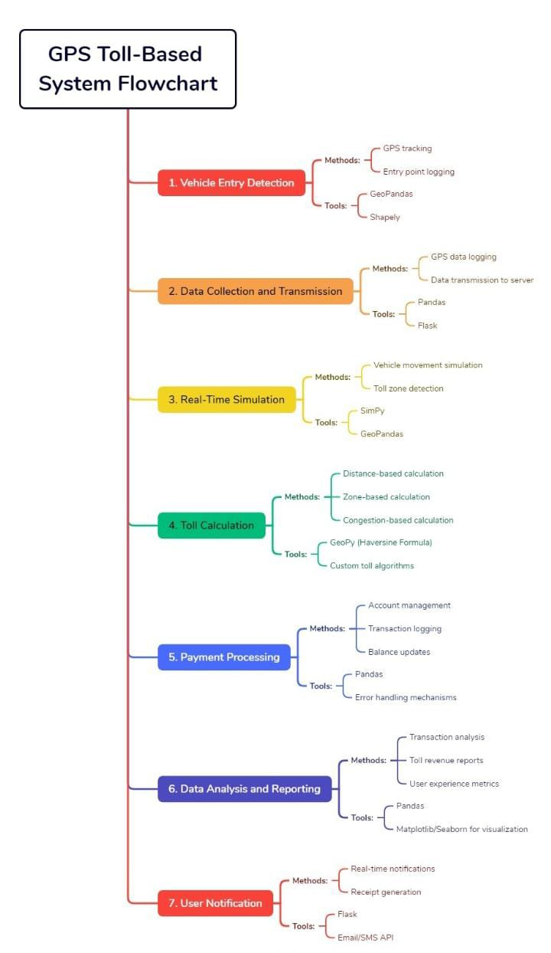
PROCESS FLOW
UI Website:
SimToll Dynamics website is opened by the admin and logged in.
Either manual entry of vehicle type, start, stop and route is chosen or the GPS app is use.
Vehicle Entry Detection:
Vehicles enter the toll zone and are detected
Real-time location data or manual data entry is sent to the simulation system
Data Collection and Transmission: (FOR LIVE GPS TRACKING OPTION)
GPS app collects location data continuously.
Data is transmitted to the central server in real time.
Real-Time Simulation:
The system models vehicle movement on the road network using SimPy.
GeoPandas and Shapely are used to map and analyze spatial data.
Toll Calculation:
The system calculates tolls based on the distance traveled by each vehicle.
Dynamic pricing adjusts toll rates according to traffic conditions.
Payment Processing:
Transactions are securely processed and recorded.
Data Analysis and Reporting:
The system analyzes traffic data and generates detailed reports.
Insights are provided on traffic patterns, toll revenue, and system performance.
User Notification:
Users receive an email of toll charges and payment confirmation.
Detailed transaction reports are available for users.

Slide 11
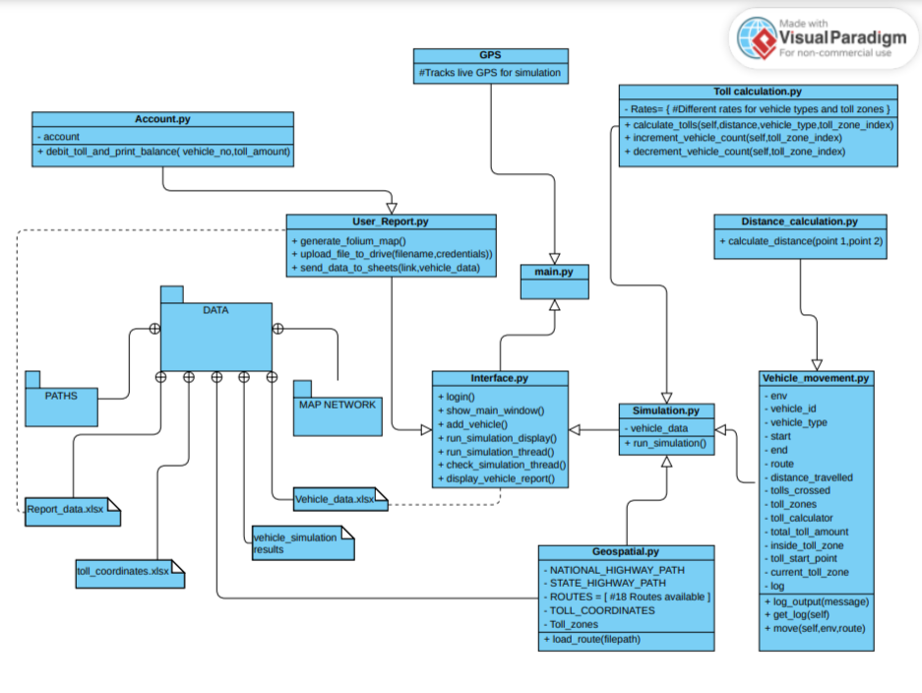
ARCHITECTURE DIAGRAM
This diagram is designed to illustrate how various modules work together to achieve real-time toll collection, data processing, and user interaction. By understanding the architecture, we can appreciate the seamless integration of different technologies and how they collectively contribute to an efficient and user-friendly tolling system.

Slide 12
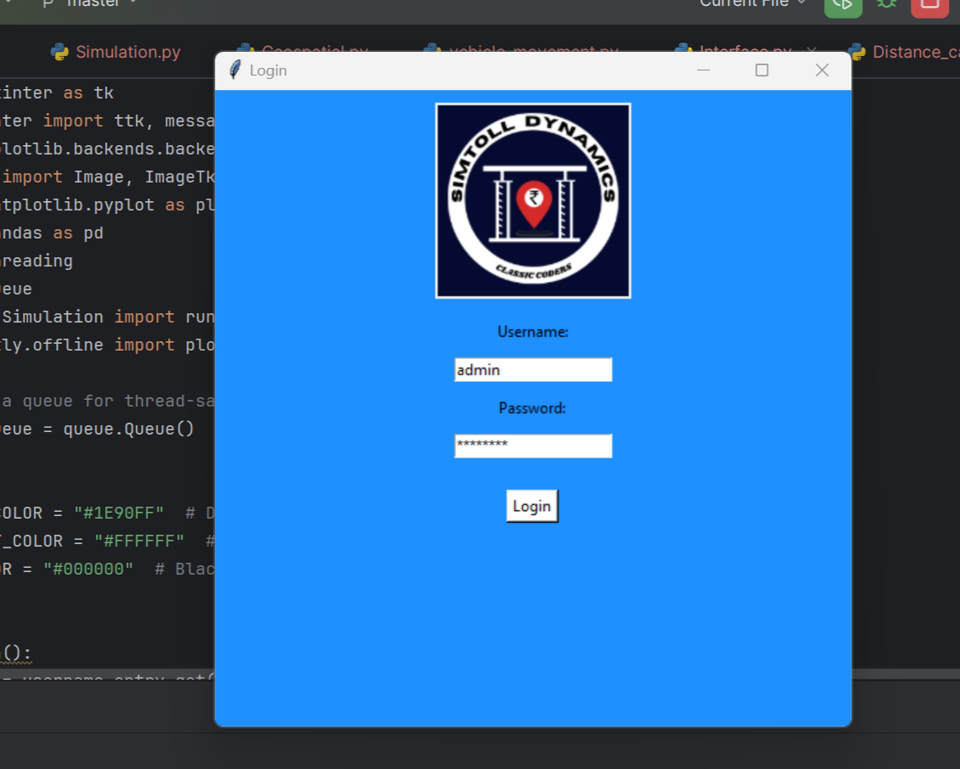
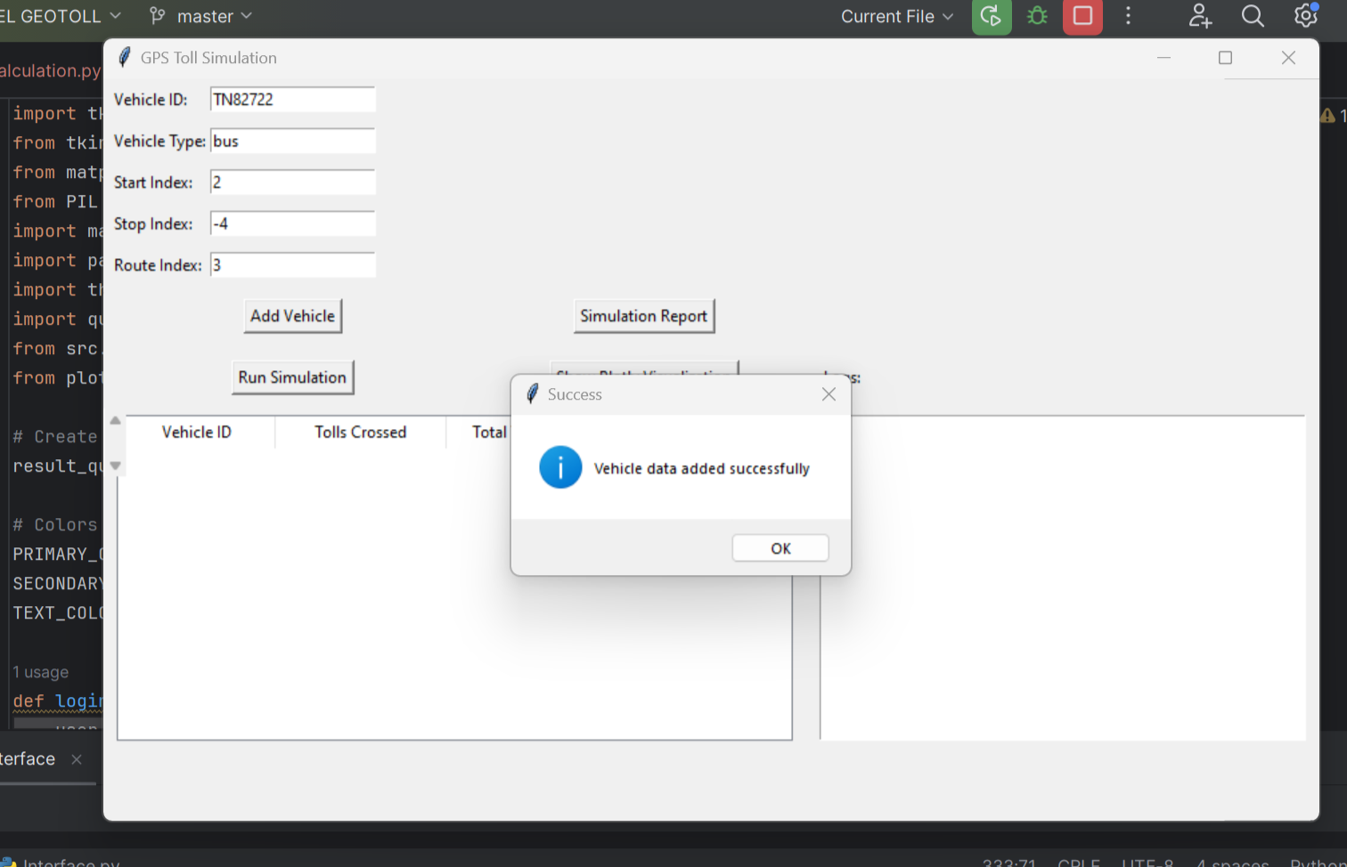
RESULTS
LOGIN PAGE
MAIN WINDOW – ADDING VEHICLE DATA

Slide 13
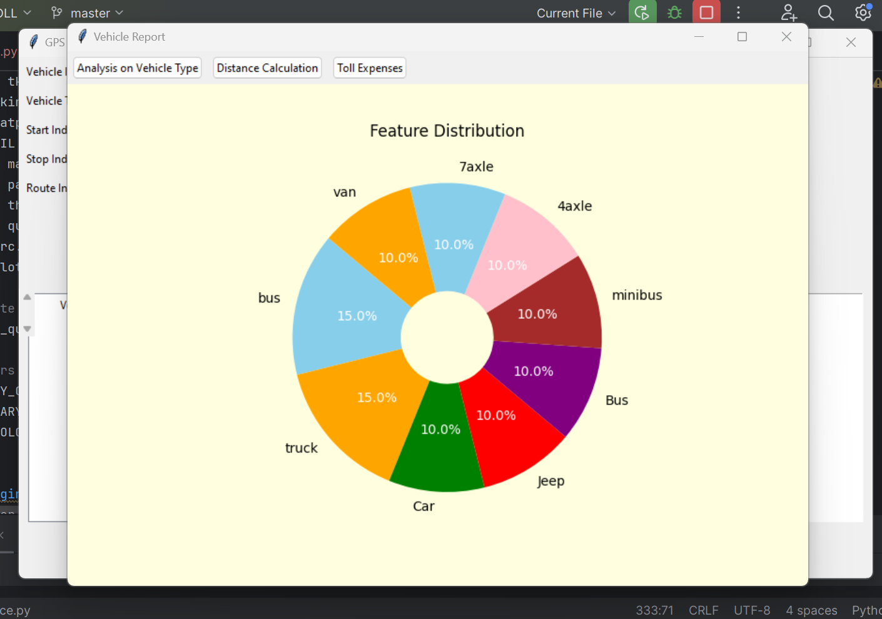

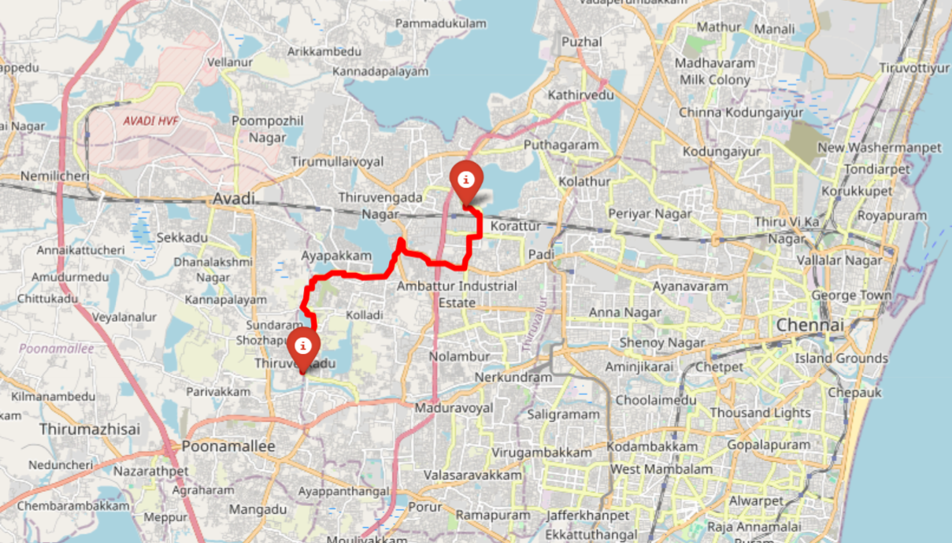
ADMIN REPORTS
USER REPORT MAIL
USER REPORT – FOLIUM MAP

Slide 14
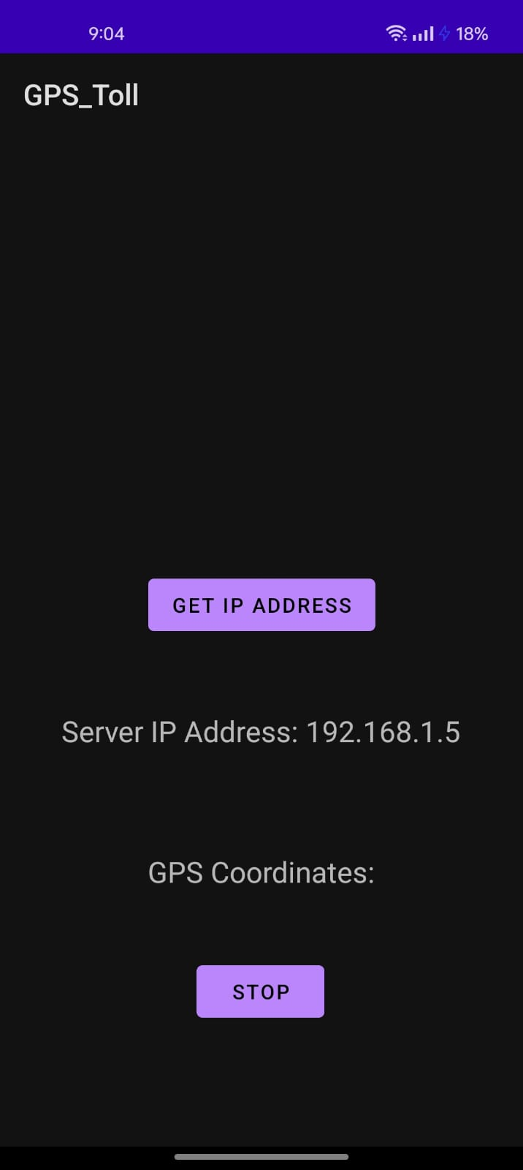
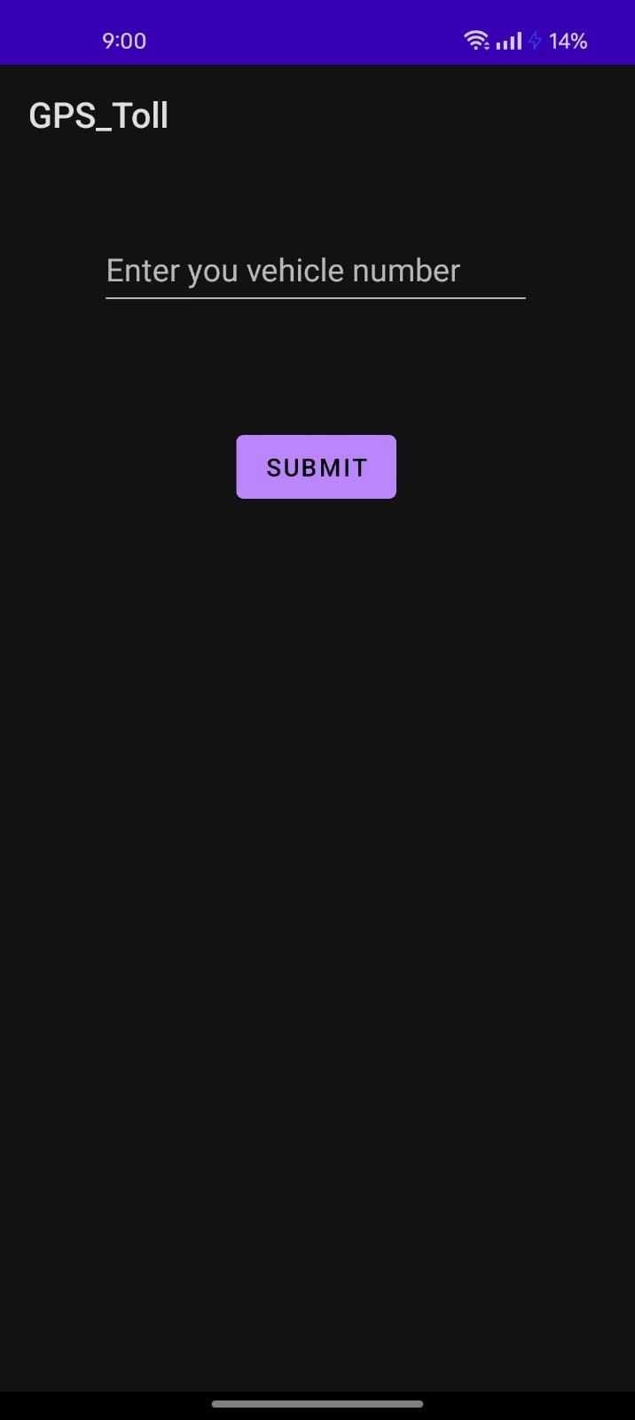
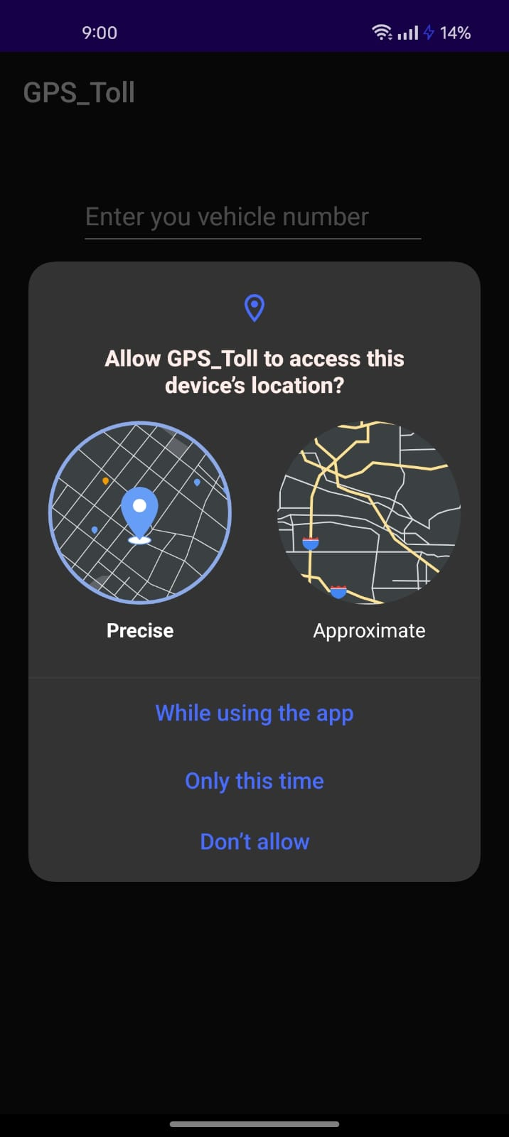
GPS TOLL APP

Slide 15

TECHNOLOGIES USED
SimPy- Models real-time vehicle movements and toll collection processes, providing a realistic and dynamic simulation environment.
GeoPandas- Handles spatial data, enabling the system to map and analyze road networks and vehicle locations accurately.
Shapely- Supports operations on geometric objects, such as calculating distances between points and creating spatial buffers.
GeoPy- Geocoding and geographic calculations.
Python- The backbone of the project acting as a general-purpose programming language
Pandas and Matplotlib- Data manipulation, visualization and analysis
Folium and Plotly- Interactive map visualization for simulation and report
Real-Time GPS- Provides live location data of vehicles if needed
Interactive Dashboard- Offers an intuitive and interactive interface for administrators
QGIS- Software used to create toll-zones and road-network shapefiles for simulation

Slide 16








MEET CLASSIC CODERS- OUR TEAM!
ATHIKA
Data Analyst
DHIKSHA
Geospatial analyst
HARSHA VARDHAN
UI and Visualization expert
TEJASWINI
Simulation engineer
ASWIN
Project manager and app developer

Slide 17

In summary, our GPS Toll-based System Simulation not only addresses the current challenges of toll collection but also sets the stage for future innovations in traffic management and urban mobility. By harnessing the power of technology, we aim to create a more efficient, transparent, and sustainable tolling ecosystem
“The road to efficiency is paved with technology”

Slide 18

THANK
CLASSIC CODERS:
ASWIN
aswin.r.2022.aml@ritchennai.edu.in
You

